Slide 1
.NET Interview Questions

Slide 2
What is the .NET Framework?
The .NET Framework is a software development platform developed by Microsoft.
It provides a controlled environment for developing and running applications.
It includes the CLR (Common Language Runtime) and the .NET class libraries.

Slide 3
What is CLR?
The Common Language Runtime (CLR) is the execution engine for .NET applications.
It provides services like memory management, garbage collection, exception handling, type safety, and security.

Slide 4
What is the difference between value type and reference type?
Value types store data directly (e.g., int, double, struct).
Reference types store a reference to the data’s memory address (e.g., class, string, array).

Slide 5
What is boxing and unboxing?
Boxing: Converting a value type to an object type.
int i = 10;
object obj = i; // boxing
Unboxing: Converting an object type back to a value type.
int j = (int)obj; // unboxing

Slide 6
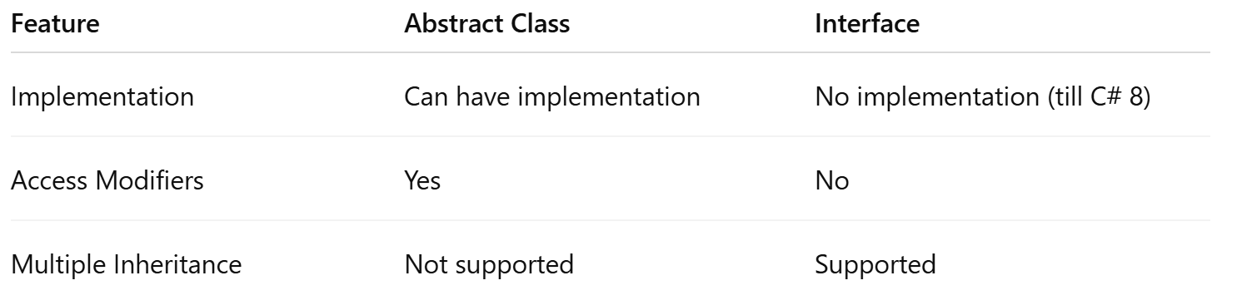
What is the difference between an abstract class and an interface?
Abstract Class: Can have implementations, fields, and constructors.
Interface: Only contains declarations; no implementation (before C# 8.0).

Slide 7
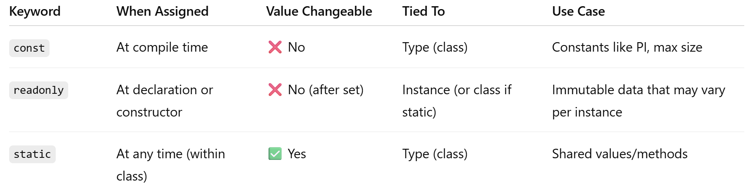
What is the difference between const, readonly, and static?
const: Compile-time constant (must assign at declaration).
readonly: Runtime constant (can assign in constructor).
static: Belongs to the class, not an instance.

Slide 8
What are delegates in C#?
A delegate is a type-safe function pointer used for defining callback methods.
public delegate void Notify();
public void Show() => Console.WriteLine("Notified!");
Notify n = Show;
n();

Slide 9
What is LINQ?
LINQ (Language Integrated Query) allows querying collections in a SQL-like syntax.
var result = list.Where(x => x.Age > 18).ToList();

Slide 10
What is garbage collection in C#?
Garbage collection automatically frees memory used by objects that are no longer referenced.

Slide 11
How do you handle exceptions in C#?
Using try-catch-finally blocks:
try {
// risky code
} catch (Exception ex) {
// handle error
} finally {
// cleanup
}

Slide 12
What is ASP.NET Core MVC?
ASP.NET Core MVC is a framework for building web applications using the Model-View-Controller (MVC) pattern.
It separates concerns:
Model = Data
View = UI
Controller = Request handling logic

Slide 13
What are the key features of ASP.NET Core MVC?
Cross-platform support
Dependency injection
Razor View Engine
Model binding and validation
Middleware and routing
Tag helpers and View Components

Slide 14
What is the difference between Razor Pages and MVC?
MVC separates model, view, and controller into separate files.
Razor Pages is page-based; each page has its model and code-behind in a single file, suitable for simpler apps.

Slide 15
How is routing handled in ASP.NET Core MVC?
Routing defines how HTTP requests map to controller actions.
app.UseRouting();
app.UseEndpoints(endpoints => {
endpoints.MapControllerRoute(
name: "default",
pattern: "{controller=Home}/{action=Index}/{id?}");
});

Slide 16
What is Model Binding and Validation?
Model Binding: Automatically maps form data or query strings to model properties.
Model Validation: Uses data annotations like [Required], [Range].
[Required]
public string Name { get; set; }

Slide 17
What are Tag Helpers?
Tag helpers enable server-side code to participate in creating and rendering HTML elements in Razor views.
<form asp-controller="Home" asp-action="Submit“ asp-area=“”>

Slide 18
What is TempData, ViewData, and ViewBag?
ViewData: Dictionary for passing data from Controller to View.
ViewData[“Name”]= “Naimish”;
ViewBag: Dynamic wrapper around ViewData.
ViewBag.Name = “Naimish”;
TempData: Persists data across one redirect (uses session under the hood).
TempData[“Name”]= “Naimish”;

Slide 19
What is Partial View and View Component?
Partial View: Reusable Razor UI fragment (like a small layout).
View Component: More powerful; includes logic and rendering.

Slide 20
How to implement file upload in ASP.NET Core MVC?
Use IFormFile to handle file uploads.
public async Task<IActionResult> Upload(IFormFile file)
{
var path = Path.Combine("uploads", file.FileName);
using var stream = new FileStream(path, FileMode.Create);
await file.CopyToAsync(stream);
}

Slide 21
What is Anti-Forgery Token and how to use it?
Prevents CSRF (Cross-Site Request Forgery) attacks.
Use @Html.AntiForgeryToken() in forms (views) and [ValidateAntiForgeryToken] in controller actions.

Slide 22
How do you manage session in ASP.NET Core MVC?
Enable session in Program.cs:
Builder.services.AddSession();
app.UseSession();
Then use it in controllers:
HttpContext.Session.SetString("Name", "John");

Slide 23
What is Razor View Engine?
Razor is a markup syntax to embed server-based code (C#) into web pages using .cshtml files.

Slide 24
What is dependency injection in ASP.NET Core?
Dependency Injection (DI) is a design pattern used to achieve Inversion of Control (IoC).
ASP.NET Core has built-in support for DI to inject services into classes.
It’s a built-in feature to inject services into controllers or classes via constructor. It promotes loose coupling.
builder.services.AddScoped<IStudentService, StudentService>();

Slide 25
What is Entity Framework Core?
EF Core is a lightweight, cross-platform ORM for .NET.
It allows developers to work with databases using .NET objects, eliminating most of the data-access code.

Slide 26
Difference between IEnumerable and IQueryable
IEnumerable executes queries in memory (client-side). | good for collections
IQueryable executes queries on the database (server-side), which is more efficient for large datasets.
It Builds expression trees; executes on DB

Slide 27
What is Middleware in ASP.NET Core?
Middleware are components that form a pipeline to handle requests and responses in ASP.NET Core.
Examples: authentication, logging, exception handling.
app.UseMiddleware<CustomMiddleware>();
Middleware is software that's assembled into the app pipeline to handle requests and responses.
Example: UseRouting(), UseAuthorization(), etc.

Slide 28
What is IActionResult and ActionResult<T>?
IActionResult is an interface for various return types (Ok(), NotFound(), etc.).
Can return any type of HTTP response.
public IActionResult Get() => Ok("Hello");
ActionResult<T> combines T with IActionResult, enabling more flexibility and strong typing.
Combines the result type with possible HTTP response types.
public ActionResult<string> Get() => "Hello";

Slide 29
What is the Repository Pattern?
It’s a design pattern that separates business logic from data access logic.
It uses a repository class to perform data operations and hides EF-specific code from the business layer.

Slide 30
What is the difference between synchronous and asynchronous actions?
Synchronous: Blocks the thread until task completes.
Asynchronous: Frees up the thread, improving scalability.
public async Task<IActionResult> Index() {
var data = await _service.GetDataAsync();
return View(data);
}

Slide 31
What is async/await in C#?
async and await are used for asynchronous programming.
They help improve application responsiveness by freeing up the thread while waiting for I/O operations.
public async Task<string> GetDataAsync()
{
return await httpClient.GetStringAsync("https://example.com");
}

Slide 32
What are filters in ASP.NET Core?
Filters are used to run code before or after controller actions:
ActionFilter : An action filter runs code before or after controller actions.
ExceptionFilter: Exception filters run when some of the exceptions are unhandled and thrown from an invoked action.
AuthorizationFilter: An authorization filter is a type of filter that enforces security policies, determining whether a user is authorized to access a specific action method or controller.
public class MyFilter : IActionFilter

Slide 33
What is the use of appsettings.json?
It stores configuration settings like connection strings, keys, URLs, etc.
Use IConfiguration to read values.
{
"ConnectionStrings": {
"Default": "Server=.;Database=TestDb;..."
}
}

Slide 34
What is ASP.NET Core Web API?
ASP.NET Core Web API is a framework for building HTTP services that can be consumed by various clients (mobile, browser, desktop).
It's cross-platform and open-source.

Slide 35
What are HTTP verbs used in Web APIs?
GET – Retrieve data
POST – Create new resource
PUT – Update entire resource
PATCH – Update part of a resource
DELETE – Remove a resource

Slide 36
What is model binding in ASP.NET Core?
Model binding maps incoming HTTP request data (query string, route, body) to action method parameters.
[HttpPost]
public IActionResult Save(Student model)
{
...
}

Slide 37
How to create routing in ASP.NET Core API?
Using attributes or conventional routing:
[Route("api/[controller]")]
[ApiController]
public class StudentsController : ControllerBase
{
[HttpGet("{id}")]
public IActionResult Get(int id) {
...
}
}

Slide 38
What is attribute routing?
It allows defining routes directly on controller actions using attributes.
[HttpGet("student/{id}")]

Slide 39
How to handle exceptions in ASP.NET Core Web API?
Use global exception middleware:
app.UseExceptionHandler("/error");
Or write custom middleware.

Slide 40
What is Swagger and why is it used?
Swagger (via Swashbuckle) generates interactive API documentation.
It helps test endpoints and understand contracts.
builder.services.AddSwaggerGen();
app.UseSwagger();

Slide 41
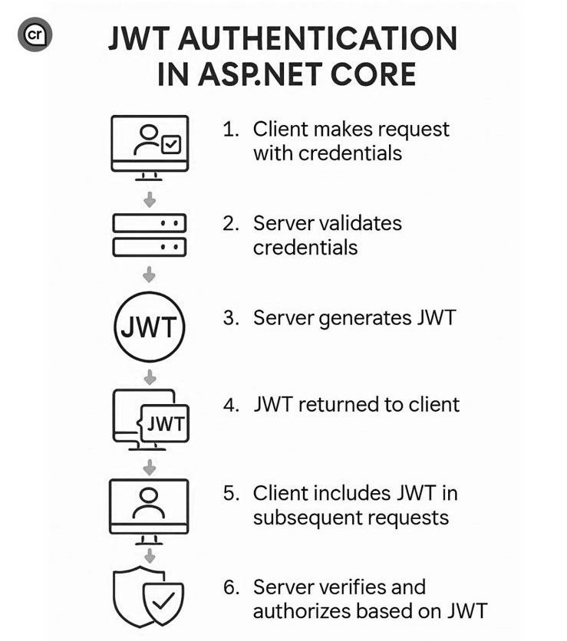
What is JWT Authentication?
JWT (JSON Web Token) is a token-based authentication mechanism used in APIs.
It contains claims and is signed with a secret key.
The client sends the JWT in the Authorization header.

Slide 42
How do you implement JWT authentication in Web API?
Install JWT package
Configure authentication in Program.cs
Use [Authorize] attribute
services.AddAuthentication(JwtBearerDefaults.AuthenticationScheme)
.AddJwtBearer(...);

Slide 43
How do you version an ASP.NET Core Web API?
Use Microsoft.AspNetCore.Mvc.Versioning package and add:
builder.services.AddApiVersioning(); (add it in program.cs)
At Controller Level
[ApiVersion("1.0")]
[Route("api/v{version:apiVersion}/[controller]")]

Slide 44
How to validate models in Web API?
Use data annotations like [Required], [StringLength]. ASP.NET Core automatically validates if [ApiController] is used.
[Required]
public string Name { get; set; }

Slide 45
How to secure Web API?
Use HTTPS
Implement JWT or Oauth
Validate user input
Avoid exposing sensitive data
Use CORS

Slide 46
What is CORS and how to configure it?
CORS (Cross-Origin Resource Sharing) allows your API to be called from different domains.
Add this in program.cs
Builder.services.AddCors();
app.UseCors(x => x.AllowAnyOrigin().AllowAnyMethod().AllowAnyHeader());

Slide 47
#1 - Restrict Page Access Based on Role
You want to allow only Admin users to access a certain page (e.g., /Admin/Dashboard).
How do you restrict access?
Add [Authorize] with roles:
[Authorize(Roles = "Admin")]
public class AdminController : Controller {
public IActionResult Dashboard() {
return View();
}
}
Ensure roles are assigned during authentication.

Slide 48
#2 - Edit Form Pre-Filled with Existing Data
In your edit form, you want to pre-fill fields with existing data from the database. How do you handle that?
[HttpGet]
public IActionResult Edit(int id)
{
var student = _context.Students.Find(id);
if (student == null)
return NotFound();
return View(student);
}
[HttpPost]
public IActionResult Edit(Student model)
{
if (!ModelState.IsValid)
return View(model);
_context.Students.Update(model);
_context.SaveChanges();
return RedirectToAction("Index");
}

Slide 49
#3 - AJAX-Based CRUD for Dynamic Page Updates
Your client wants the create, update, and delete operations to happen without full page reloads.
How would you do this in MVC?
Use jQuery AJAX:
$.ajax({
url: '/Student/Create',
type: 'POST',
data: $('#createForm').serialize(),
success: function(result) {
$('#studentList').html(result);
}
});
In controller, return a Partial View:
[HttpPost]
public IActionResult Create(Student model)
{
_context.Students.Add(model);
_context.SaveChanges();
var students = _context.Students.ToList();
return PartialView("_StudentList", students);
}

Slide 50
#4 - Centralized Error Handling
How do you catch unexpected exceptions across your entire application and show a custom error page?
app.UseExceptionHandler("/Home/Error"); [Program.cs]
Create Error action:
public IActionResult Error() {
return View(); // Custom error page
}

